Slide 1
ECG
ZAHRA JAVADY NEJAD, MD
Tehran University of Medical Sciences

Slide 2
The ECG is the most important test for interpretation of the cardiac rhythm, conduction system abnormalities, and for the detection of myocardial ischemia. The ECG is also of great value in the evaluation of other types of cardiac abnormalities including valvular heart disease, cardiomyopathy, pericarditis, and hypertensive disease.

Slide 3
ECG waves are labeled alphabetically starting with the P wave, followed by the QRS complex and the ST-T-U complex (ST segment, T wave, and U wave). The J point is the junction between the end of the QRS and the beginning of the ST segment.

Slide 4
ECG GRID — The electrocardiogram (ECG) is a plot of voltage on the vertical axis against time on the horizontal axis.

Slide 6
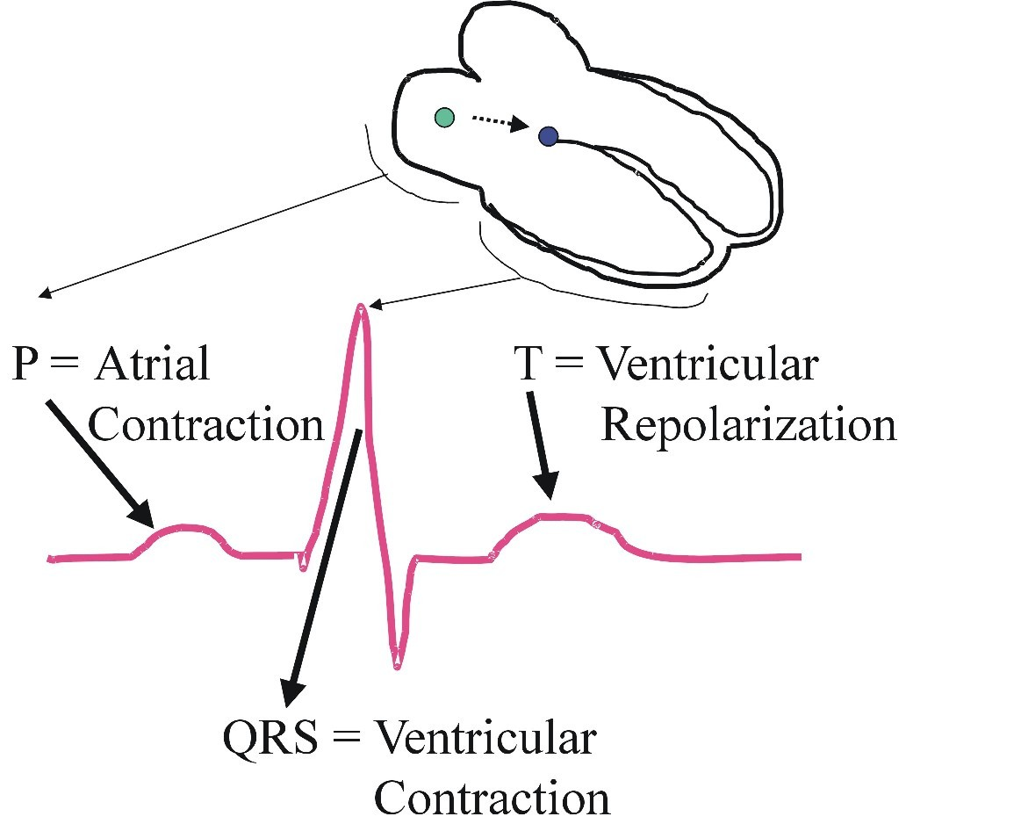
EKG Measurement Process
The 12-lead ECG allows the depolarization and repolarization of the heart to be detected
Depolarization of the Atrium produces the P-Wave on the EKG printout
The complex QRS-Wave of the printout is produced through ventricular depolarization
Finally, the EKG’s T-Wave is produced when the ventricle repolarizes.

Slide 8
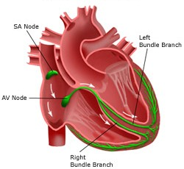
Conduction Path
Purkinje Fibers

Slide 9
Conduction Path
Start of conduction path
SA node is located in the upper right atrium
This is the main pacemaker of heart, kick starting the depolarization of the atriums, forcing blood into the ventricles.
Purkinje Fibers

Slide 10
P wave — The P wave represents atrial depolarization.

Slide 11
P wave duration and amplitude — The P wave is normally less than 120 milliseconds in duration and under 1.5 or 2 mm (or in some texts 2.5 mm) in height in standard lead II.

Slide 12
●Upright in leads I, II and usually aVF
●Inverted in aVR
●Upright, biphasic or inverted in III and aVL

Slide 14
PR interval — The PR interval includes the P wave as well as the PR segment. It is measured from the beginning of the P wave to the first part of the QRS complex (which may be a Q wave or R wave). It includes time for atrial depolarization (the P wave) and conduction through the AV node and the His-Purkinje system (which constitute the PR segment).

Slide 15
The PR interval — The normal PR interval is 120 to 200 milliseconds. The PR interval tends to shorten as the heart rate increases due to rate-related shortening of action potentials .

Slide 16
QRS complex — The QRS complex represents the time for ventricular depolarization.
●If the initial deflection is negative, it is termed a Q wave. Small Q waves are often seen in leads I, aVL, and V4-V6 as a result of initial septal depolarization and are considered normal.

Slide 17
The first positive deflection of the QRS complex is called the R wave. It represents depolarization of the left ventricular myocardium. Right ventricular depolarization is obscured because the left ventricular myocardial mass is much greater than that of the right ventricle. The small R wave in lead V1 represents initial septal depolarization.

Slide 18
The negative deflection following the R wave is the S wave, which represents terminal depolarization of the high lateral wall.
●If there is a second positive deflection, it is known as an R'.
●Lower case letters (q, r, or s) are used for relatively small amplitude waves of less than 0.5 mV (less than 5 mm with standard calibration).

Slide 19
●An entirely negative QRS complex is called a QS wave.
The entire QRS duration normally lasts for 0.06 to 0.10 seconds (1½ to 2½ small boxes) and is not influenced by heart rate.

Slide 20
The R wave should progress in size across the precordial leads V1-V6. Normally there is a small R wave in lead V1 with a deep S wave. The R wave amplitude should increase in size until V4-V6, due to more left ventricular forces being seen, while the S wave becomes less deep. This is termed R wave progression across the precordium.

Slide 21
ST segment — The ST segment occurs after ventricular depolarization has ended and before repolarization has begun. It is a time of electrocardiographic silence. The initial part of the ST segment (the intersection of the end of the QRS complex and the beginning of the ST segment) is termed the J point .

Slide 23
The ST segment is usually isoelectric (ie, zero potential as identified by the T-P segment) and has a slight upward concavity. However, it may have other configurations depending upon associated disease states (eg, ischemia, acute myocardial infarction, or pericarditis).

Slide 24
In these situations, the ST segment may be flattened, depressed (below the isoelectric line) with an upsloping, horizontal, or downsloping morphology, or elevated in a concave or convex direction (above the isoelectric line).

Slide 25
T wave — The T wave represents the period of ventricular repolarization.

Slide 26
QT interval — The QT interval consists of the QRS complex, the ST segment, and T wave. Thus, the QT interval is primarily a measure of ventricular repolarization.

Slide 27
U wave — A U wave may be seen in some leads, especially the precordial leads V2 to V4. The exact cause of this wave is uncertain, although it has been suggested that it represents repolarization of the His-Purkinje system.

Slide 28
The amplitude of the U wave is typically less than 0.2 mV and is clearly separate from the T wave. It is more evident in some circumstances such as hypokalemia and bradycardia. The U wave may merge with the T wave when the QT interval is prolonged (a QT-U wave), or may become very obvious when the QT or JT interval is shortened (eg, with digoxin or hypercalcemia).

Slide 29
The normal QRS electrical axis, as established in the frontal plane, is between -30 and 90º (directed downward or inferior and to the left) in adults. An axis between -30º and -90º (directed superior and to the left) is termed left axis deviation.

Slide 30
If the axis is between 90º and 180º (directed inferior and to the right), then right axis deviation is present. An axis between -90º and -180º (directed superior and to the right) is referred to as extreme right or left axis.

Slide 32
The QRS axis can be determined by examining all of the limb leads, but the easiest method involves looking at leads I, II, and aVF only .
●If the QRS complex is positive (upright) in both leads I and II, then the axis falls between -30 and 90º, and the axis is normal.

Slide 33
If the QRS complex is positive in lead I but negative in lead II, then the axis is leftward (-30 to -90º).
●If the complexes are negative in lead I and positive in aVF, then the axis is rightward (90 to 180º).
●If the complexes are negative in both I and aVF, then the axis is extreme (180 to -90º).

Slide 34
The causes of right axis deviation include:
●Normal variation (vertical heart with an axis of 90º)
●Mechanical shifts, such as inspiration and emphysema
●Right ventricular hypertrophy
●Right bundle branch block
●Left posterior fascicular block
●Dextrocardia

Slide 35
Causes for left axis deviation include:
●Normal variation (physiologic, often with age)
●Mechanical shifts, such as expiration, high diaphragm (pregnancy, ascites, abdominal tumor)
●Left ventricular hypertrophy
●Left bundle branch block
●Left anterior fascicular block

Slide 36
APPROACH TO ECG INTERPRETATION — A systematic approach to interpreting an electrocardiogram (ECG) is essential for correct diagnosis.
Step 1: Rate — Is the rate between 60 and 100? Rates less than 60 are bradycardic and greater than 100 are tachycardic.
Step 2: Rhythm — Are P waves present? Is there a P wave before every QRS complex and a QRS complex after every P wave? Are the P waves and QRS complexes regular? Is the PR interval constant?

Slide 37
Step 3: Axis — Is there left or right axis deviation?
Step 4: Intervals — What is the PR interval? Short PR intervals are suggestive of Wolff-Parkinson-White syndrome. Long PR intervals are usually seen in first degree AV block, but there may be other causes. What is the QRS interval? Long QRS intervals represent a bundle branch block, ventricular pre-excitation, ventricular pacing, or ventricular tachycardia. What is the QT interval? Short and long QT intervals may be present.

Slide 38
Step 5: P wave — What is the shape and axis of the P wave? The P wave morphology should be examined to determine if the rhythm is sinus or from another atrial location.Amplitude and duration should also be analyzed to determine left and right atrial enlargement.
Step 6: QRScomplex — Is the QRS wide? If so, examination of the morphology can determine if there is left or right bundle branch block or pre-excitation present. In addition, increased voltage may indicate left or right ventricular hypertrophy. Are Q waves present, suggestive of infarction?

Slide 40
Right Bundle Branch Block

Slide 41
Step 7: ST segment-T wave — Is there ST elevation or depression compared to the TP segment? The TP segment, between the T wave of one beat and the P wave of the next beat, should be used as the baseline. Are the T waves inverted? Abnormalities of the ST segment or T wave may represent myocardial ischemia or infarction, among other causes.
Step 8: Overall interpretation — Only after the prior steps have been completed should an overall interpretation and possible diagnoses be determined. This ensures assimilation of all information in the ECG and that no detail will be overlooked.

Slide 42
Normal sinus rhythm (NSR) is the characteristic rhythm of the healthy human heart. NSR is the rhythm that originates from the sinus node.

Slide 43
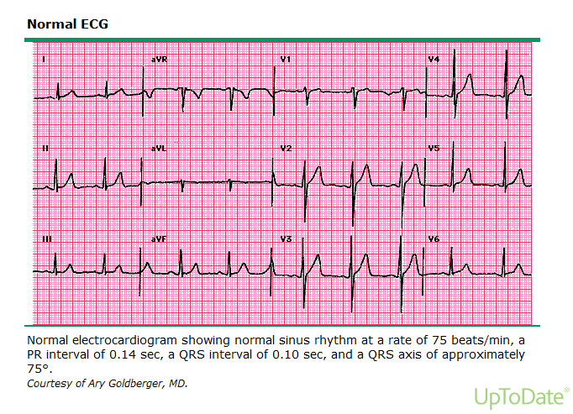

Slide 44
The rate in NSR is generally regular but will vary depending on autonomic inputs into the sinus node. There can be an irregularity in the sinus rate and, when this occurs, it is termed "sinus arrhythmia".

Slide 45
NORMAL SINUS HEART RATE — The normal heart rate has been considered to be between 60 and 100 beats per minute, although there is some disagreement with regard to the normal rate in adults. The range (defined by 1st and 99th percentiles) is between 43 and 102 beats per minute in men and between 47 and 103 beats per minute in women.

Slide 46
ELECTROCARDIOGRAPHIC
CHARACTERISTICS OF
NSR

Slide 47
SINUS ARRHYTHMIA — Sinus arrhythmia is defined as an irregularity in the rate of normal sinus rhythm. Sinus arrhythmia is considered present when there is a variation in the P-P interval by 0.12 seconds (120 msec) or more but atrial activation appears to be occurring via the sinus node.

Slide 49
A systematic approach to interpretation of the ECG is critically important.

Slide 50
●Rate – Is the rate between 60 and 100?
●Rhythm – Is it normal sinus or other?
●Axis – Is there axis deviation?
●Intervals – Are all intervals normal?
●P wave – What is its height, width, and axis?
●QRS complex – Are there pathologic Q waves, bundle branch block, or chamber hypertrophy?
●ST-T waves – Is it isoelectric, elevated, or depressed relative to the TP segment?
●Overall interpretation – What is the diagnosis?

