Slide 1
Guidelines for the diagnosis and treatment of Pulmonary hypertension associated with systemic sclerosis

Slide 2
Pulmonary arterial hypertension (PAH) was considered as the leading cause of morbidity and mortality in systemic sclerosis (SSc) in the last two decades .

Slide 3
The patients with SSc and PAH have about 50-60% estimated 3 year survival.
Hachulla, E.,Coghlan ,G., EULAR Textbook on Systemic Sclerosis, 2013.

Slide 4
The prevalence of PAH associated with scleroderma is 8-12%.
Mukerjee, D., et al., 2003. Prevalence and outcome in ….. Annals of the rheumatic diseases, 62(11), pp.1088-1093.

Slide 5
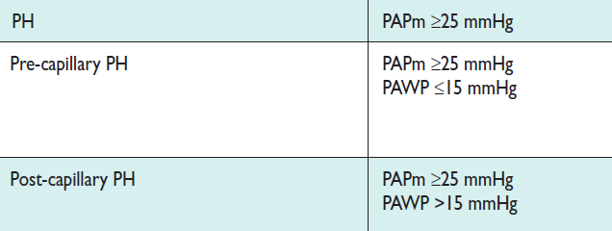
Haemodynamic definitions of pulmonary hypertension

Slide 6
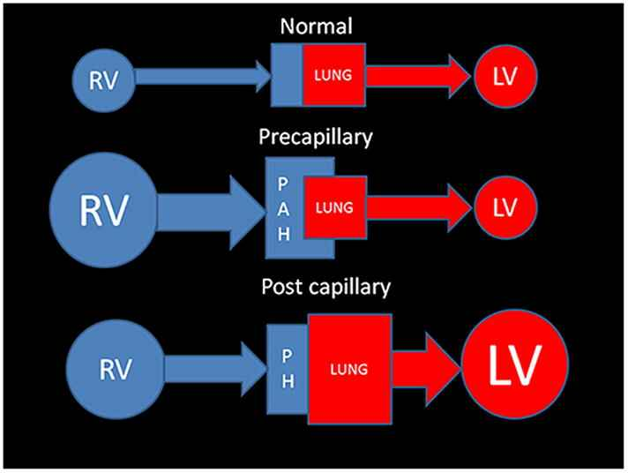

Slide 7
Mechanisms of pulmonary hypertension in systemic sclerosis:
PH with proliferative pulmonary vasculopathy = PAH
PH associated with lung fibrosis
Pulmonary Venous hypertension
pulmonary veno-occlusive disease(PVOD)
Hachulla, E.,Coghlan ,G., EULAR Textbook on Systemic Sclerosis, 2013.

Slide 8
PVOD is an important point in systemic sclerosis,therefore briefly explained:

Slide 9
Pulmonary veno-occlusive disease (PVOD) is a rare condition that represents a small subgroup of adult patients with pulmonary hypertension (PH) .

Slide 10
In patients with systemic sclerosis and PVOD,there is also arteriolar microangiopathy and it may causes pulmonary edema after treatment with PAH specific vasodilators.
Montani, D., et a.2008. Pulmonary veno-occlusive disease… Medicine, 87(4).

Slide 11
The diagnosis of PVOD can be established with a high probability by the combination of
clinical suspicion,
physical examination,
bronchoscopy and
radiological findings.
Montani D, et al. Pulmonary veno-occlusive disease…Medicine (Baltimore) 2008.

Slide 12
HRCT findings include
subpleural thickened septal lines,
mediastinal lymphadenopathy and
centrilobular ground glass opacities.
Günther, S., et al.2012. Computed tomography findings of ... Arthritis & Rheumatism, 64(9).

Slide 13
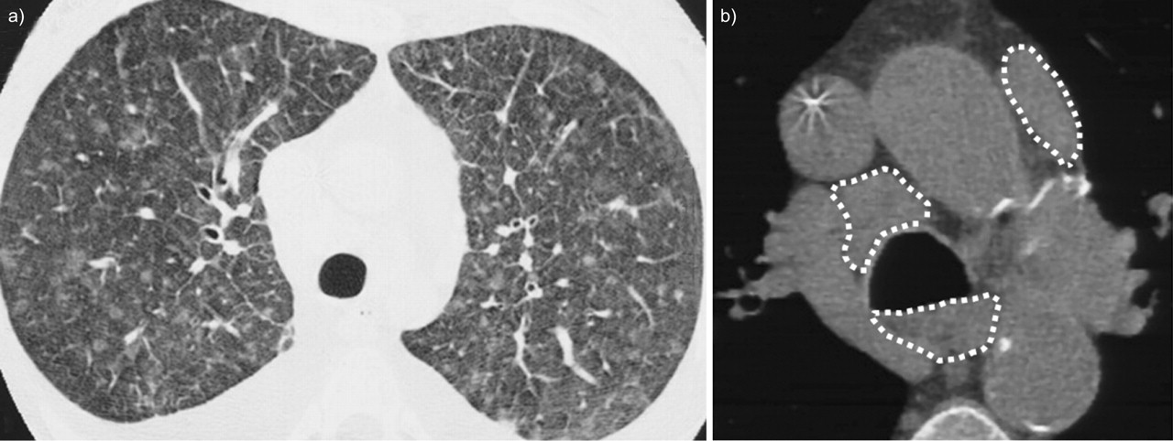

Slide 14
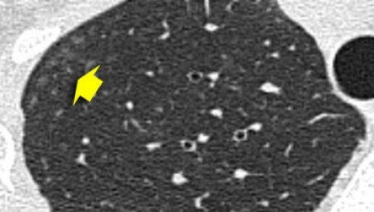
Ill defined centrilobular nodules of ground glass density

Slide 15
In PVOD, the pulmonary vasodilators are usually not useful and sometimes can cause pulmonary edema, therefore the diagnosis of PVOD is critical.

Slide 16

Pulmonary hypertension screening

Slide 17
Resting echocardiography is recommended as a screening test in asymptomatic SSc patients.
2015 ESC/ERS Guidelines for the diagnosis and treatment of pulmonary hypertension .

Slide 18
Also annual screening with echocardiography,
DLCO and biomarkers is recommended.

Slide 19
Echocardiographic probability of pulmonary hypertension
2015 ESC/ERS Guidelines for the diagnosis and treatment of pulmonary hypertension .

Slide 20
Peak tricuspid regurgitation velocity >2.8 m/s
AND
Presence of other echo ‘PH signs’

Slide 21
other echo ‘PH signs’
RV/LV basal diameter ratio
Flattening of the interventricular septum
Early diastolic PI velocity
PA diameter
RV outflow acceleration time
IVC diameter- inspiratory collapse
RA area (end-systole)

Slide 22
LV diastolic function (including Tissue Doppler)

Slide 23
LV diastolic dysfunction is present in 23% of SSc patients.
Doppler parameters alone do not provide optimal insight into impaired LV relaxation.

Slide 24
Therefore Tissue Doppler Imaging is critical for the comprehensive evaluation of diastolic function.

Slide 25
Biomarkers:
markers of myocardial stress:
brain natriuretic peptide (BNP)
and
NT-proBNP

Slide 26
correlate with myocardial dysfunction and provide prognostic information at the time of diagnosis and during follow-up assessments.

Slide 27
NT-proBNP seems to be a stronger predictor of prognosis.

Slide 28
Based on Mukerjee et al.,2003 and Williams et al.,2006; N-terminal pro-brain natriuretic peptide(NT-pro BNP) values significantly correlated with haemodynamics.
-Mukerjee, D., et al., 2003. Prevalence and outcome in ….. Annals of the rheumatic diseases, 62(11), pp.1088-1093.
-Williams, M.H., et al.2006. Systemic sclerosis associated pulmonary hypertension: Heart, 92(7) .

Slide 29
We can detect an additional 27% of patients with pulmonary hypertension with adding serum NT-pro BNP>100 pg/ml and DLCO<60% of expected to the findings of echocardiography.
Khanna,D., et al.( 2010) Predictive value of non-invasive …: PHAROS registry . [abstract].Arthritis and Rheumatism.

Slide 30
Right heart catheterization(RHC)
To confirm the diagnosis of pulmonary hypertension and to assess the severity of haemodynamic impairment ,RHC is needed.
2015 ESC/ERS Guidelines for the diagnosis and treatment of pulmonary hypertension .

Slide 31
During RHC, evaluation of the pressure of
PA,
PA wedge position,
RV and
RA must be done.
2015 ESC/ERS Guidelines for the diagnosis and treatment of pulmonary hypertension .

Slide 32
Decision making about the next step after the echocardiography is :

Slide 33
Echocardiographic probability of pulmonary hypertension
2015 ESC/ERS Guidelines for the diagnosis and treatment of pulmonary hypertension .

Slide 34
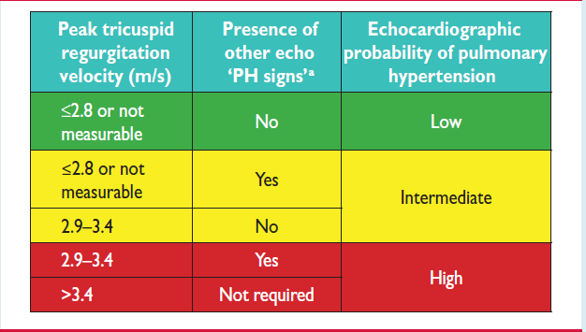

Slide 35
Echocardiographic probability of PH | Next step in management
Low | Echo follow-up should be considered
Intermediate | Further assessment of PH including RHC should be considered
High | RHC

Slide 36
Therapy
Based on 2015 ESC and ERS guidelines for the diagnosis and treatment of pulmonary hypertension, the overall treatment goal in patients with PAH is:

Slide 37
achieving a low risk status ,
which is usually associated with:
good exercise capacity,
good quality of life,
good RV function and
a low mortality risk.

Slide 38
Risk assessment of patients will be performed based on next table.
2015 ESC/ERS Guidelines for the diagnosis and treatment of pulmonary hypertension .

Slide 39
Determinants of prognosisª (estimated 1-year mortality) | Low risk <5% | Intermediate risk 5–10% | High risk >10%
Clinical signs of right heart failure | Absent | Absent | Present
Progression of symptoms | No | Slow | Rapid
Syncope | No | Occasional syncopeb | Repeated syncopec
WHO functional class | I, II | III | IV
NT-proBNP plasma levels | BNP <50 ng/l NT-proBNP <300 ng/l | BNP 50–300 ng/l NT-proBNP 300–1400 ng/l | BNP >300 ng/l NT-proBNP >1400 ng/l
echocardiography | RA area <18 cm2 No pericardial effusion | RA area 18–26 cm2 No or minimal, pericardial effusion | RA area >26 cm2 Pericardial effusion
Haemodynamics | RAP <8 mmHg CI ≥2.5 l/min/m2 SvO2 >65% | RAP 8–14 mmHg CI 2.0–2.4 l/min/m2 SvO2 60–65% | RAP >14 mmHg CI <2.0 l/min/m2 SvO2 <60%

Slide 40
Clinical signs of right heart failure
Progression of symptoms
Syncope
WHO functional class
NT-proBNP plasma levels
Echocardiography
Haemodynamics

Slide 41
Determinants of prognosisª (estimated 1-year mortality) | Low risk <5%
Clinical signs of right heart failure | Absent
Progression of symptoms | No
Syncope | No
WHO functional class | I, II
NT-proBNP plasma levels | BNP <50 ng/l NT-proBNP <300 ng/l
echocardiography | RA area <18 cm2 No pericardial effusion
Haemodynamics | RAP <8 mmHg CI ≥2.5 l/min/m2 SvO2 >65%

Slide 42
Determinants of prognosisª (estimated 1-year mortality) |  |  | High risk >10%
Clinical signs of right heart failure |  |  | Present
Progression of symptoms |  |  | Rapid
Syncope |  |  | Repeated syncopec
WHO functional class |  |  | IV
NT-proBNP plasma levels |  |  | BNP >300 ng/l NT-proBNP >1400 ng/l
echocardiography |  |  | RA area >26 cm2 Pericardial effusion
Haemodynamics |  |  | RAP >14 mmHg CI <2.0 l/min/m2 SvO2 <60%

Slide 43
General measures

Slide 44
The patients should be encouraged to be active to tolerable extent but should avoid excessive physical activity.

Slide 45
The 2015 PH guidelines suggested that oral anticoagulation may be considered on an individual basis and in the presence of thrombophilic predisposition. Class IIb, Level c.

Slide 46
Based on the 2015 PH guidelines, diuretic treatment is recommended in patients with signs of RV failure and fluid retention. Class I, Level c.

Slide 47
Continuous long-term O2 therapy is recommended in patients when arterial blood O2 pressure is consistently < 60 mmHg. Class I, Level c.
2015 ESC/ERS Guidelines for the diagnosis and treatment of pulmonary hypertension .

Slide 48
Regular monitoring of the iron status should be considered in these patients. If iron deficiency be detected, a search for potential causes must be done and treatment should be considered.
2015 ESC/ERS Guidelines for the diagnosis and treatment of pulmonary hypertension .

Slide 49
Specific
drug
therapy
-Hachulla, E.,Coghlan ,G., EULAR Textbook on Systemic Sclerosis, 2013.
- 2015 ESC/ERS Guidelines for the diagnosis and treatment of pulmonary hypertension .

Slide 50

Endothelin receptor antagonists
Bosentan , an oral active dual endothelin receptor type A and B antagonist, is recommended of this class.

Slide 51
The starting dosage is 62.5 mg twice daily and increased to 125 mg twice daily after 1month if there are no liver function test derangements or other important adverse effects.

Slide 52
In patients receiving bosentan, liver function testing should be performed monthly.

Slide 53
Phosphodiesterase type 5 inhibitors
Sildenafil and tadalafil are recommended of this class. Sildenafil,20 mg three times daily and tadalafil,20 mg once daily(and then increase to 40 mg daily) are recommended.

Slide 54
Most side effects of these drugs are mainly related to vasodilation including of headache, flushing and epistaxis.

Slide 55
Prostacyclin analogues and prostacyclin receptor agonists
Iloprost is a chemically stable prostacyclin analogue available as intravenous or aerosol administration.

Slide 56
Inhaled iloprost
Overall, inhaled iloprost was well tolerated. The inhaled form has been shown to improve exercise tolerance and symptoms when administered 6-9 times daily. The most frequent side effects are jaw pain and flushing.

Slide 57
Intravenous iloprost
Intravenous iloprost with starting dose of 0.5ng/kg/min and increase to maximum dose 2ng/kg/min for 6 hour in 5 consecutive days, has shown exercise performance and hemodynamic benefits.

Slide 58
Transplantation
SSc should not be considered as an a priori contraindication for lung transplantation.

Slide 59
About indications and contraindications for transplantation in patients with systemic sclerosis:

Slide 60
decision making must be with a special focus on
digestive (gastro-esophageal reflux disease and intestinal disease),
cardiac,
renal and
cutaneous involvement.

Slide 61
The treatment algorithm of our center is shown in next figure.
Achievement/maintenance of a low-risk profile considered to be an adequate treatment response .

Slide 62
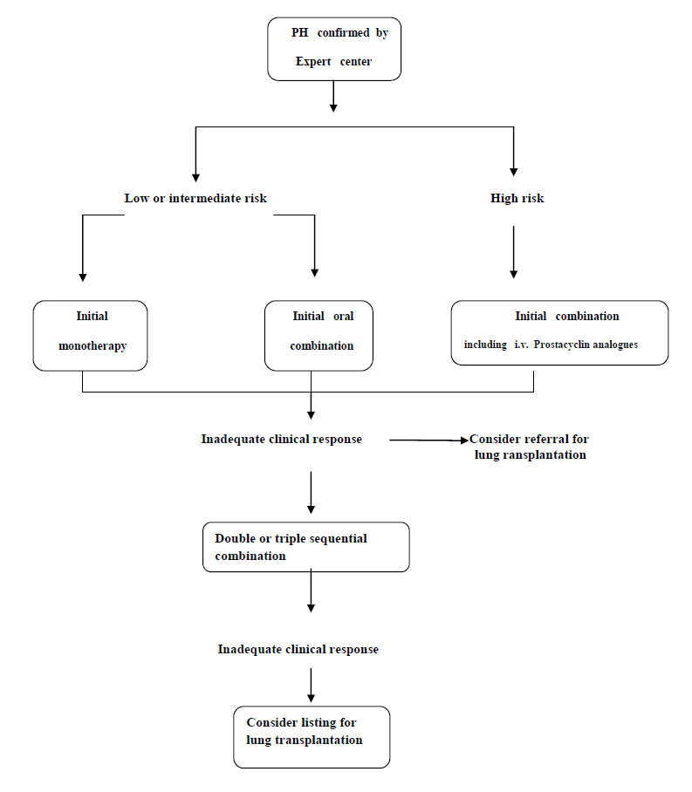

Slide 63
In our center assessment of the patients and timing for the follow-up is based on the next table.

Slide 64
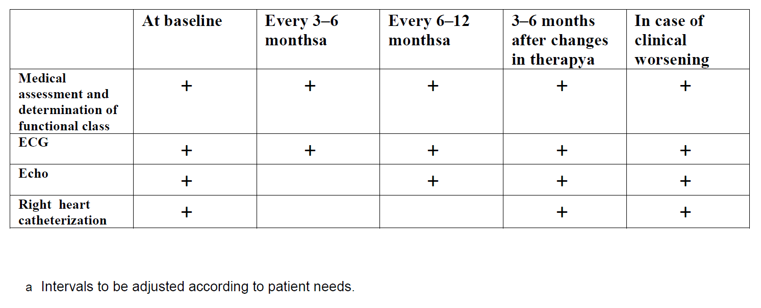

Slide 65
If the patient
refuses to
RHC

Slide 66
OR

Slide 67
Lack
of
facilities

Slide 68
After twice echocardiography within three months with evidence of intermediate to high echocardiographic probability of pulmonary hypertension and

Slide 69
after R/O PVOD, we start the treatment of PH with Phosphodiesterase type5 inhibitor ,Tadalafil .

Slide 70
Low dose
Close observation

Slide 71

OUR DATA

Slide 72
A total of 262 patients who underwent TTE:
Patints with Peak tricuspid regurgitation velocity >2.8 m/s:71 (27%)

Slide 73
Patints with RA area:24 (9.2%)
Patints with RV size:32 (12.2%)
Patints with LV diastolic dysfunction: 24 (9.2%)

Slide 74
23 patients underwent RHC .
50% concordance between ECHO and RHC results.

Slide 75


